Slide 1
Current state of Scotland's information systems to support migration, ethnicity and health research, policy and practice
Andrew Millard, Equalities Intelligence Manager NHS Health Scotland
Notes:
Good afternoon everyone, and welcome to Scotland. I am Andrew Millard, the Equalities Intelligence Manager at NHS Health Scotland. As migrant health becomes an increasing policy priority, I have started finding out more about the data and I want to give you an overview of what I’ve discovered so far about information sources available in Scotland on migration and ethnicity and how they relate to health data. As I go, I will show you examples of how they are used. I’ll talk first about the migration systems and then about the ethnicity systems.

Slide 2
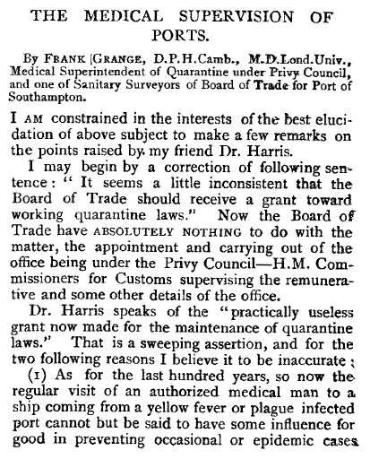
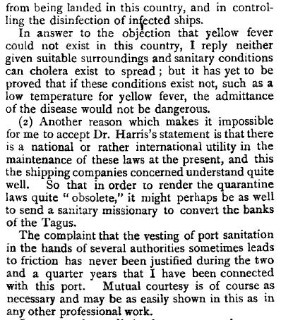
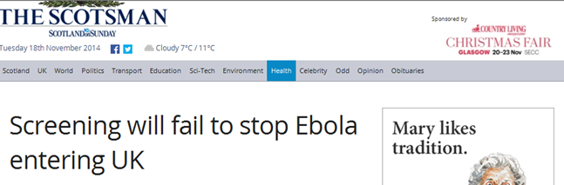
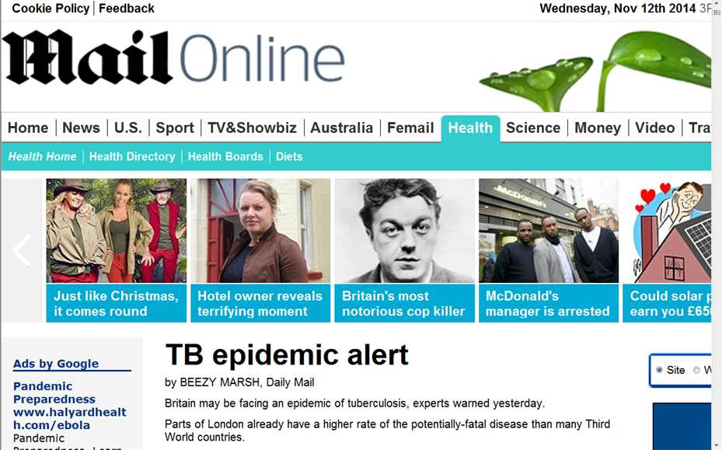
Public Health 1895 (7, 102)
“the regular visit of an authorised medical man to a ship coming from a yellow fever or plague infected port cannot but be said to have some influence for good” …
Notes:
Here is an extract from a paper published in Public Health nearly 120 years ago. Dr Frank Grange, the Medical Superintendent of Quarantine under the Privy Council argues that the requirement for ships to enter a period of quarantine to prevent the spread of disease is not obsolete. The main concern then was for port sanitation – the prevention of disease transmission.
NEXT
The difference between then and now is that, in theory at least, we now have the means to support our work with better data, and don’t have to rely on assertion alone. But although the diseases have changed, the prevention problem remains, and unfortunately, for Dr Grange perhaps, it seems Port Health is no longer enough:
NEXT, Next

Slide 3
Definitions
Migrants
Dimensions used in definitions used by UK databases:
  Nationality,
  Country of birth,
  Length of stay (see Migration Observatory¹ and United Nations²)
Migrant workers (examples from definitions)
are or have been ‘engaged in a remunerated activity’, (See United Nations 1990³, 2003)
came to the UK ‘within the past 5 years specifically to find or take up work’ (Health and Safety Executive 2006⁴)
Immigration, Emigration and Net Migration
1 http://www.migrationobservatory.ox.ac.uk/briefings/who-counts-migrant-definitions-and-their-consequences
2 http://stats.oecd.org/glossary/detail.asp?ID=1562
3 http://www.un.org/documents/ga/res/45/a45r158.htm
4 http://www.hse.gov.uk/research/rrpdf/rr502.pdf (p15)
Notes:
Long term migrant – stays >12 months (Organisation of Economic Co-operation and Development 2001)
“The term ‘migrant worker’ refers to a person who is engaged or has been engaged in a remunerated activity in a State of which he or she is not a national.” (United Nations 1990³, ratified 2003)
“Those who have come to the UK within the last five years specifically to find or take up work, whether intending to remain permanently or temporarily and whether documented or undocumented.” (Health and Safety Executive 2006⁴)
Migration consists of both immigration into a country and emigration out of a country. The difference between these two is termed ‘net migration

Slide 4
Migrant Data Sources
International Passenger Survey (IPS)
Labour Force Survey (LFS)
National Insurance Number (NINo) Registration
National Health Service Central Register (NHSCR)
Community Health Index Number (CHI)
Census 2011
Other sources
National Records Scotland (NRS) and Office for National Statistics (ONS)
Scottish Migrant and Ethnic Health Research Strategy Group (SMEHRS)
Notes:
This is what I’ll cover in the migration section of the talk
International Passenger Survey (IPS)
Labour Force Survey (LFS) (actual destinations)
Used to estimate Scotland’s share of total UK inward migration, based on IPS figures. The LFS provides more reliable data on the actual geographical distribution of immigrants, rather than the intended destination provided by the IPS. LFS uses families and individuals, quarterly, 98,000 cases in latest quarter (to March 2014) simple random sample, cross-sectional. These retrospectively adjusted IPS data give trends over time, called the Long term Migration estimates, (see http://www.ons.gov.uk/ons/taxonomy/index.html?nscl=International+Migration)
National Insurance Number (NINO) Registration (mostly migrant workers)
Breakdowns by country and health board, but no routine figures for Scottish Health Boards
National Health Service Central Register (NHSCR) (GP registrations , NHS Boards flows)
Migration share to health boards in Scotland, is tracked using GP registration information, and the NHS Central Register (NHSCR). Out-migration is based solely on the IPS.
Community Health Index Number (CHI) (migration between NHS Boards)
Census 2011 – online tables, adhoc analyses, linkage
Other sources, - Education statistics, Scottish Social Attitudes Survey, Language line statistics - I’ll discuss in more detail later
National Records of Scotland (NRS) and Office for National Statistics (ONS) collate numbers of immigrants, emigrants and net flows to councils, health boards and Scotland to rest of the UK and Scotland to overseas countries, providing tables but no demographic data apart from age group and sex. http://www.nrscotland.gov.uk/statistics-and-data/statistics/statistics-by-theme/migration/migration-statistics/total-migration-to-or-from-an-area
SMEHRS gives strategic direction through its annual reports.

Slide 5
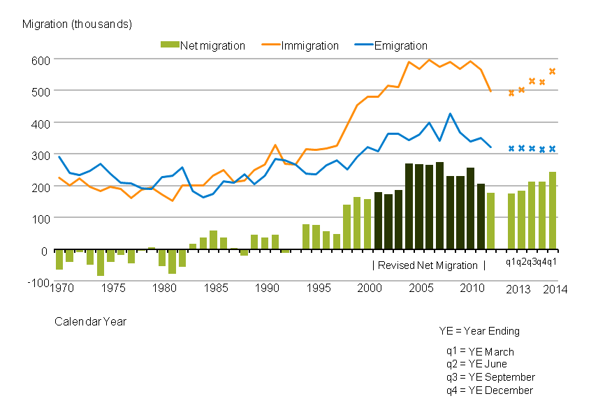
  International Passenger Survey (IPS)
  Total long-term international migration estimates, UK, 1970 to 2014
Source: Long-term International Migration - Office for National Statistics
Notes: Figures for the years ending March, June, September and December 2013 and for the year ending March 2014 are provisional rolling quarterly estimates and are denoted by a cross. All other figures are final calendar year estimates of LTIM.
Source: http://www.ons.gov.uk/ons/rel/migration1/migration-statistics-quarterly-report/august-2014/sty-net-migration.html
Notes:
Here are some IPS statistics produced by the ONS. The chart shows the trend in immigration (orange line) emigration (blue line) and the difference between them (net migration - the bars) to the UK flattened after 2005 and the overall net figure increased following the accession of A8 EU countries in May 2004.
The IPS conducts 700-800 000 interviews per year at all major ports of entry to the UK. It asks about intended destinations and reasons for migration.

Slide 6
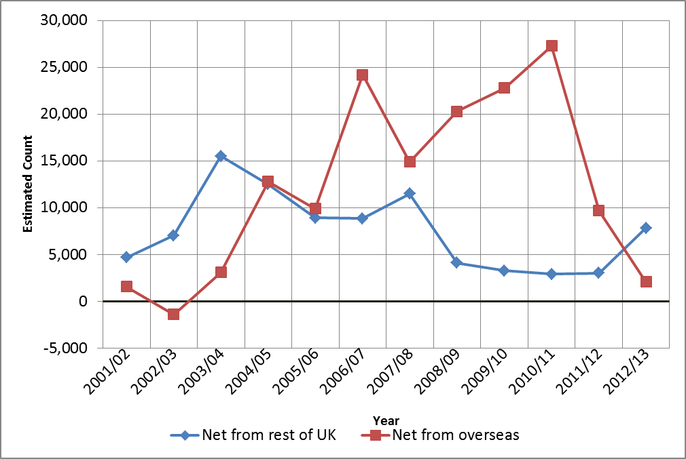
Scottish estimated net migration, UK and overseas
Source: IPS and LFS, data held in NRS spreadsheet ‘In, out and net migration between Scotland and the rest of the UK/overseas, 2001/02 to most recent’
http://www.nrscotland.gov.uk/statistics-and-data/statistics/statistics-by-theme/migration/migration-statistics/total-migration-to-or-from-an-area
Notes:
Here are the NRS estimates for Scotland. Like the UK we see a steep decline in migration estimates after 2010-11 in net migration to Scotland from overseas, but an increase to Scotland from the rest of the UK from 2011-12.
The NRS estimates use the LFS results to adjust the IPS estimates. The LFS carries out c 100,000 interviews per quarter, to get a cross section of the population using simple random sampling, this gives better information on actual destinations.
These are flows, whereas the total numbers of migrants in Scotland in a particular year would be termed ‘stocks’, which is migration-speak for prevalence or the total estimate of migrants living in Scotland at any one time. Caveat: 95% CIs (not given) are large and can fluctuate from year to year

Slide 7
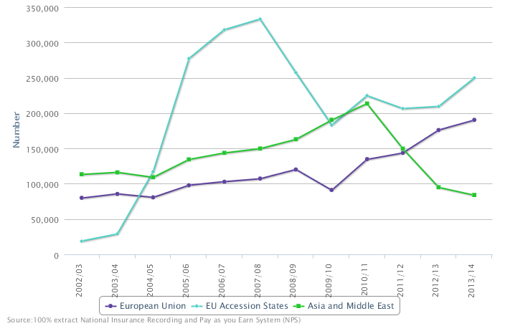
UK National Insurance Registrations for the three largest groups of Migrant Workers 2002-2014
Source: https://sv.stat-xplore.dwp.gov.uk/views/#view=ninoview2&selectedWafers=0&selectedColumns=1,2,5&selectedRows=0,1,2,3,4,5,6,7,8,9,10,11
See also: https://www.gov.uk/government/uploads/system/uploads/attachment_data/file/348047/NINo_Analytical_Report_Aug14.pdf
Notes:
Migrant workers who are allocated an insurance number on entry to the UK are counted by the Office for National Statistics (ONS) and detailed statistics are available on their country of origin and the benefits they claim, including ESA and incapacity, lone parents, carers, bereavement and disability. The graph is produced from the DWP stat Xplore tool. Gender age band and country groups can be altered. This information is not routinely available for Scotland, but it can be produced for local authorities in Scotland, as demonstrated by reports available on the NRS website.
http://www.gro-scotland.gov.uk/files2/stats/migration/Migration-Reports/ayrshire-migration-report.pdf
And also https://stat-xplore.dwp.gov.uk/
See DWP response to
Freedom of Information request 27/2012
Received 4th January 2012
Published 2012
Information request
Please provide details on National Insurance number registrations in SCOTLAND to adult overseas nationals entering the UK and claiming an out-of-work benefit within 6 months of registration, by year of registration.
I am aware that this information is published on a UK basis in and I would like to receive the same information with data for SCOTLAND.
https://www.gov.uk/government/uploads/system/uploads/attachment_data/file/221240/foi-27-2012.pdf

Slide 8
Migration: some relevant data fields from the Scottish Census 2011
  Country of birth
  Nationality
  Whether a student, or looking for work
  Occupation
  Ethnicity, religion, and other demographic data
  General health data, long term conditions
  Month/year of arrival in UK*
  How well can speak English*
  Language spoken at home*
NHS Data linkage is needed for full health analysis
See 2011 census on http://www.scotlandscensus.gov.uk/health * New in 2011
Notes:
*New fields in 2011 – giving time in UK, language spoken at home, how well can speak English.
The census also includes data on whether the long term conditions limit day to day activities, educational level and on carer responsibilities.
The Scottish census (unlike in England and Wales) cannot distinguish short and long term migrants (Q11 arrived before/ after 27/3/2010 and Q12 how long they intend to stay if arrived after 27.3.2010 – this Q is asked after the one on month and year of arrival) . No user need identified or other higher priority needs identified in Scotland. However month and year of arrival are collected in Scotland.

Slide 9
Example of Census 2011 data on migration
Ethnic group by age of arrival in the UK
Includes 'White: Gypsy/Traveller', 'White: Polish' and 'White: Other White'.
Source: Census data explorer, see http://www.scotlandscensus.gov.uk/ods-web/standard-outputs.html from tableDC2801SC
Notes:
This is extracted from a standard table available online from the census data explorer. All the age ranges are given in the full table. These data are for Scotland but can be broken down by health board and council areas.
The ‘White Other’ group has the highest percent born outside the UK (Gypsy travellers and White Eastern Europeans)

Slide 10
Notes:
NRS local migration spreadsheet tool. Lothian is the area around Edinburgh, while Dumfries and Galloway is a rural area bordering England. Note as before net negative migration equal net emigration.
You can choose any of the datasets I mentioned and the area, to compare up to three areas.

Slide 11
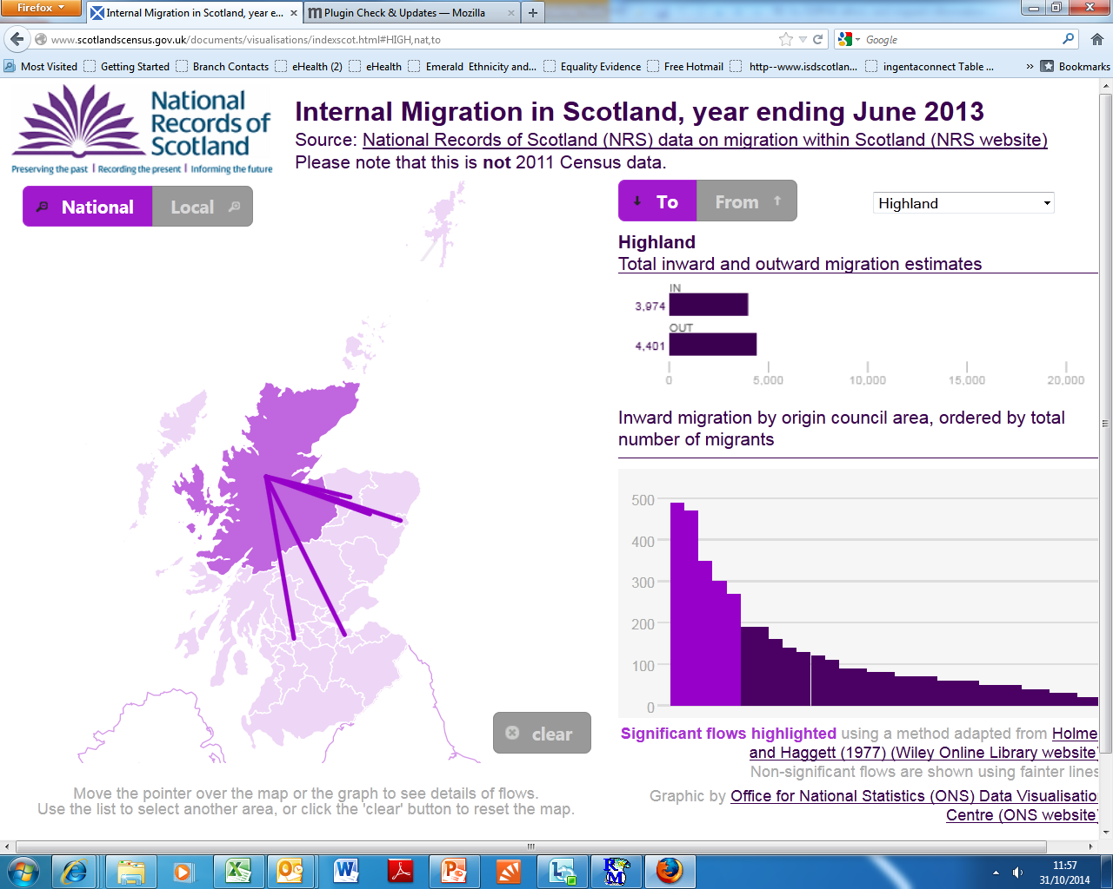
Source: http://www.scotlandscensus.gov.uk/documents/visualisations/indexscot.html
Notes:
NRS data visualization tool for local migration. It shows immigration and emigration for any local authority.

Slide 12
Scottish health information systems and ethnicity
Scottish Census
Routine service based systems – service use
National Records Scotland – Births, deaths
Population Surveys
Linkage of the above
Notes:
I’ll cover these information sources, giving some examples of the evidence they can give as I go.

Slide 13
Ethnicity (Scottish Census 2011)
Notes:
This Census table is available online. These are the ethnic groupings used in the 2011 Census in Scotland and the latest 2011 census figures. The minority ethnic groups have all increased since 2001, except for White Scottish, which decreased by 13,000.
Data on ethnicity are within Scottish control to a greater extent than migration data, and are collected through the Scottish census and other routine Scottish data systems.
There are harmonised questions for ethnicity now recommended by the Scottish government for population surveys. These mirror the census questions to give the same categories for analysis.
And harmonised questions are available for other demographic characteristics relevant to equality. See Core and harmonised survey questions 2012 http://www.scotland.gov.uk/Topics/Statistics/About/SurveyHarm/corealldownload.
16% are in any ethnic minority, 4% of these are white and non white.

Slide 14
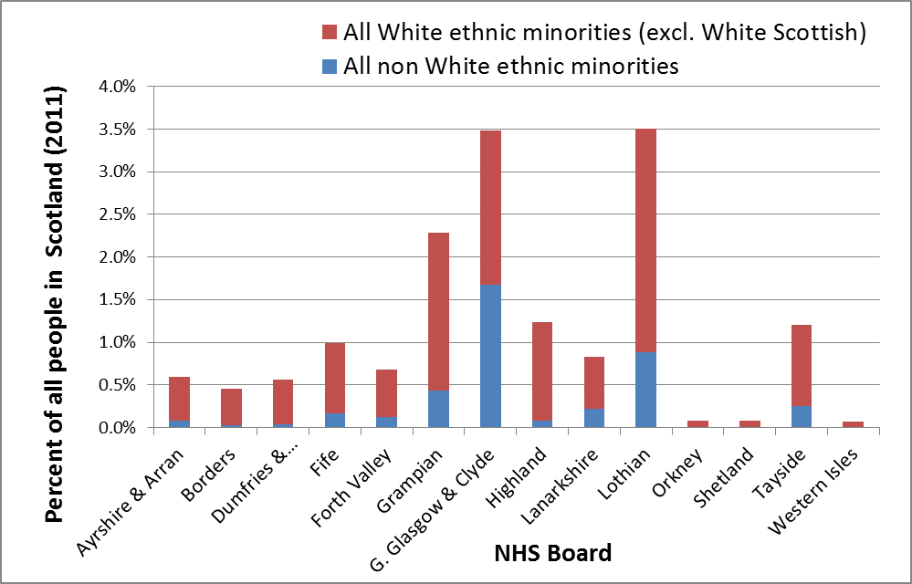

National distribution of people reporting ethnic minority identity, by Scottish NHSBoard
Source: Census 2011 data Table KS201SC - Ethnic group http://www.scotlandscensus.gov.uk/ods-web/standard-outputs.html
Notes:
This is how the 4% non-White and 12% White ethnic minorities in Scotland are distributed between Scottish health boards. They are predominantly in Greater Glasgow and Lothian (the area around Edinburgh), but Grampian (the area in the North east around Aberdeen also has a sizeable proportion. The non white, are more likely to live in the Greater Glasgow area, while the White minorities tend to live in the Lothian, Grampian and Highland areas, but appear more evenly spread.
The variation in ethnic minority population size is also wide (the largest number being in Greater Glasgow & Clyde Glasgow has 42% of the Scottish non white ethnic population, and 22% of the Scottish ethnic minority population as a whole. GGC has 88,000 people reporting as non white ethnic minorities (7%) and 184,000 reporting as any ethnic minority (15% of the population there– census 2011 figures).

Slide 15
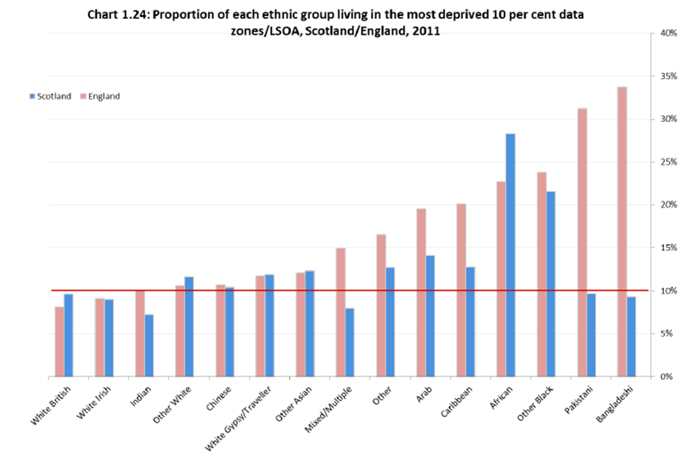


Scottish Government Statistician Group. Overview of Equality Results from the 2011 Census Release 2. http://www.scotland.gov.uk/Publications/2014/03/7340/17#c1.23, 2014.
Notes:
Besides tables, the census team produce reports on aspects of the data, one of these covers equality results including ethnicity. This chart shows where different ethnic groups live. The proportion of each ethnic group living in the most deprived 10% of datazones in Scotland, is compared with the same measure in England. A Scottish datazone contains on average 800 people, (min 500) an English LSOA (lower layer super output areas) is comparable containing 1-3,000 people
Overall, a lower proportion of ethnic minority groups live in the most deprived 10 percent of areas in Scotland than in England. There are exceptions – African people and also, Polish people who are included in this chart with other White.

Slide 16
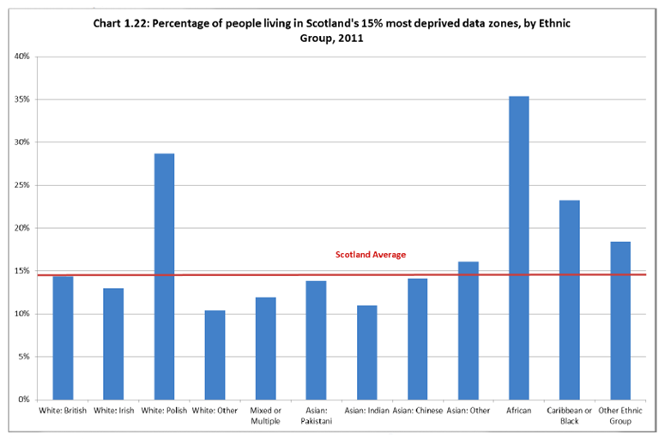
Notes:
This census chart (also from the report) disaggregates the other White group. It shows white Polish people are disproportionately represented in the most deprived 15% of areas, otherwise the distribution is similar.

Slide 17
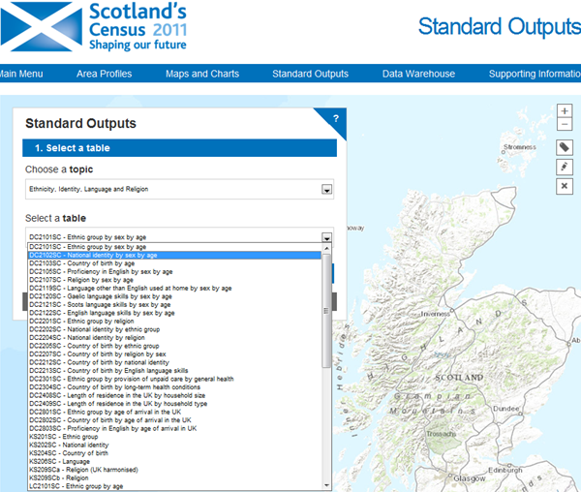
Census reports
http://www.scotlandscensus.gov.uk/ods-web/standard-outputs.html
Notes:
The census provides us with standard ethnicity analyses for a variety of geographies through an interactive tool.

Slide 18
Examples of tables relating to ethnicity and health available from the 2011 census
Long term health problem or disability by Ethnic group by age (LC3205SC )
General Health by ethnic group by age (LC3206SC )
Proficiency in English by age of arrival in the UK (LC2803SC )
Ethnic group by provision of unpaid care by general health (LC2301SC )
These can be reported for a variety of geographies
http://www.scotlandscensus.gov.uk/ods-web/standard-outputs.html
Notes:
The 2011 census has over 60 standard output tables relating to ethnicity, identity, language and religion. These are four I selected looking at specific health related issues.
LC3205SC Long term health problem or disability by Ethnic group by age
LC3206SC General Health by ethnic group by age
LC2803SC Proficiency in English by age of arrival in the UK
LC2301SC Ethnic group by provision of unpaid care by general health
These can be reported for a variety of geographies
The limitation of the census is its lack of data on detailed morbidity by diagnostic group and detailed information on health behaviours and attitudes. (Though long term illness is covered at high level)
Ad hoc analyses can be carried out, but there may be a charge.

Slide 19
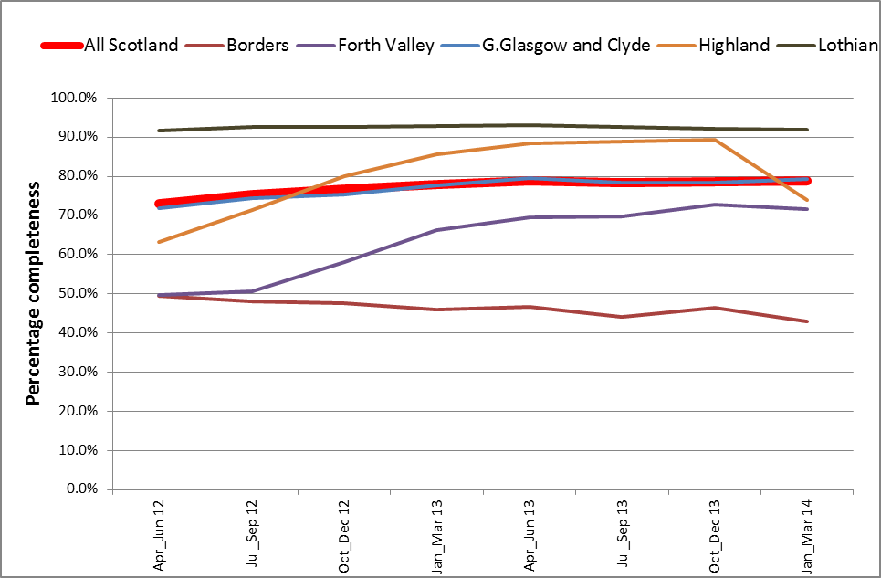
Hospital data – completeness of ethnic group field – Scotland and selected Health Boards 2012-2014
http://www.isdscotland.org/Health-Topics/Equality-and-Diversity/
Notes:
The collection of ethnicity information in hospital inpatient data has improved steadily at Scottish level over the past few years.
The latest figures for Scotland as a whole show 79% inpatient completion. This proportion has remained flat for the past year. The chart shows there is also a lot of variation between health boards in ethnicity completeness rates.
Health Boards cover geographical areas in Scotland. Their populations vary between 1.1 million people for Greater Glasgow & Clyde and 22,000 for the Orkney islands and 850,000 for Lothian, 114,000 for Borders, a remote and rural area in the south of Scotland (2013 figures). There is also a lot of variation between health boards in ethnicity completeness rates, (above).
The completeness of ethnicity collection in outpatients data has also improved but remains lower than for hospital data at 70%.
In early 2013, routine data in addictions, (87% but not standard groupings) mental health (74%) and maternity records (58%) had good ethnicity completion levels, but recording was only at around 15% in A&E.

Slide 20
Validating routine data
AMI: South Asians compared to non South Asians 2001-03 and 2009-11
Millard,A.; Guthrie,C.; Fischbacher,C.; Jamieson,J. Pilot ethnic analysis of routine hospital admissions data and comparison with census linked data: CHD rates remain high in Pakistanis. http://www.emeraldinsight.com/journals.htm?issn=1757-0980&volume=5&issue=3&articleid=17086535&show=abstract
Notes:
A study attempting to validate routine ethnicity collection in health data compared heart attack risk for south Asian and non south Asian people in 2009-2011 with the results from an earlier study using 2001-03 census data. Both studies showed similar levels of raised risk (Incidence Rate Ratios) for South Asian men and women compared to White Scottish men and women. Four health boards were selected for this study because they had completeness levels over 50% in July-September 2011 .
The data were disaggregated for CHD admissions and showed that rates remained high in Pakistanis (and unexpectedly low in White Irish). The Scottish Ethnic and Migrant Health Strategy and Steering Group is now seeking to catalyse further disaggregation (eg Bangladeshis) using the larger numbers now available.
Routine collection of ethnicity data in primary care is still being further developed. One Health Board (Lothian) has a pilot project collecting data on additional needs in primary care for use in booking hospital appointments. Such things as whether a translator is needed, or whether a large print appointment letter is needed can make all the difference between a successful and a wasted or missed appointment.

Slide 21
National Records of Scotland data
- Births by country of birth of mother
http://www.nrscotland.gov.uk/statistics-and-data/statistics/statistics-by-theme/vital-events/general-publications/vital-events-reference-tables/2013/section-3-births
Notes:
These data are just for births, unlike the census data for country of birth I showed earlier which were for all people. This table has been edited but all the groupings contain data for individual constituent countries in the original data, and 2008 and 2011, 2012. These data come from the National Records Scotland, they are not census or health service data.
A relatively recent development has been the introduction of the collection of ethnicity data on death registration now happening in Scotland (from 2012). This is starting to provide a useful resource which now requires exploration to assess data quality and completeness, however in the first 6 months, 96.4 percent of those registering a death gave the ethnicity of the deceased (Dixon 2012, SHERSS conference, Glasgow, http://elearning.healthscotland.com/course/view.php?id=492).
National Records Scotland collects data on nationality and country of birth based on the Annual Population Survey (The APS is a UK and Scottish survey which comprises key variables from the Labour Force Survey (LFS), all its associated LFS boosts and the APS boost sample, (http://www.scotland.gov.uk/Topics/Statistics/Browse/Labour-Market/Publications).
From this it makes annual population estimates by ethnicity based on the previous 10 year census. Although an individual’s ethnicity at death can be collected there is no collection of ethnicity at birth.

Slide 22
Deaths, by country of birth of deceased, Scotland, 1971 to 2013
578
597
Source:Table 5.3 http://www.nrscotland.gov.uk/statistics-and-data/statistics/statistics-by-theme/vital-events/general-publications/vital-events-reference-tables/2013/section-5-deaths
Notes:
This is just to make the point that NRS has for many years collected and published the number of deaths broken down by the deceased’s country of birth. Table 5.3 shows the “traditional” groupings of countries, but individual countries are not shown. 1972-2012 data have been cut from this table.
You can see the numbers of deaths have gone down in each category since 1971, except European Union and British Common Wealth.

Slide 23
Other Population Surveys
Scottish Health Survey
Scottish Household Survey
Scottish Schools Adolescent Lifestyle and Substance Use Survey
Scottish Crime and Justice Survey
Health Behaviour in School aged Children Survey
Further details via the ScotPHO website
http://www.scotpho.org.uk/publications/overview-of-key-data-sources/introduction
Notes:
A wealth of data are collected through established, but non-statutory surveys of health behaviours and attitudes.
These now all include a question on ethnicity.
Scottish Health Survey sample: c.6,500,
the Scottish Household Survey (biennial, sample 10,600),
the Integrated Household Survey sample in Scotland ?12k, 30-40k??), The IHS consists of core questions from the APS (LFS + boosts) and the living costs and food survey (LCS). UK sample is c.340,000 individual respondents.
Topics covered by the IHS include sexual identity, perceived general health, smoking prevalence, education, housing and employment. http://www.ons.gov.uk/ons/guide-method/method-quality/specific/social-and-welfare-methodology/integrated-household-survey/index.html
the Scottish Schools Adolescent Lifestyle and Substance Use Survey (SALSUS), target sample 35,000 in 2010
the Scottish Crime and Justice Survey, sample: 12,000 pa, and the
Health Behaviour in School Aged Children Survey sample 6,771 quadrennially. All except HBSC collect ethnicity data themselves (but only the IHS collects migrant data). There may be the possibility of linking some of them to census data. The ScotPHO website gives further details of these surveys.
http://www.scotpho.org.uk/publications/overview-of-key-data-sources/introduction
The SHS has produced a topic report on equality by combining several years of data. One example of an analysis is of prevalence of diabetes:

Slide 24
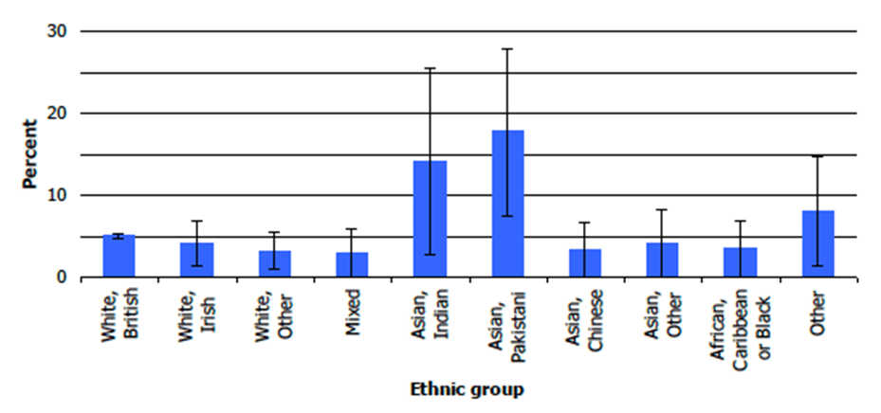
Prevalence of doctor diagnosed diabetes, by ethnic group, 2008-2011 combined (Scottish Health Survey Topic Report: Equality Groups)
(Age standardised percentages)
http://www.scotland.gov.uk/Publications/2012/10/8988/0
Notes:
The SHS has produced a topic report on equality by combining several years of data. One analysis is of prevalence of diabetes.

Slide 25
Data Linkage – Scottish Health Ethnicity Linkage Study (SHELS)
Topics:
  heart disease,
  stroke,
  cancer,
  mental health, and
  the relationship between ethnic group and socioeconomic groups and health.
A final phase is underway on infectious diseases and all cause morbidity and mortality.
Planning for 2011 census linkage is underway
  See: Bhopal R, Fischbacher C, Povey C, Chalmers J, Mueller G, Steiner M, et al. Cohort profile: Scottish health and ethnicity linkage study of 4.65 million people exploring ethnic variations in disease in Scotland. Int J Epidemiol 2011 10;40(5):1168-1175 http://ije.oxfordjournals.org/content/40/5/1168.full.
Notes:
The limitations of the routine and health information systems – lack of complete ethnicity data and lack of detailed health data - can be overcome through linking census data to a variety of routinely collected and more ad-hoc data sources.
The Scottish Health and Ethnicity linkage Study (SHELS) aimed to link census records from the 2001 census to health and mortality records, and has achieved high linkage rates. SHELS is a comprehensive examination of ethnic differences in mortality and morbidity.
The data linkage process that has been developed for SHELS has been described in one of the early papers produced by the Scottish Health Ethnicity Linkage Study (SHELS). The key requirement is for anonymity.
[anonymity so that no single individual involved in the research process can identify a person in the study. The linkage process used a combination of exact and probabilistic methods to attach a unique identifier used in the Scottish health service (the CHI number), the identifiers were then encrypted using an irreversible process. For non-health service data other linkage methods using available identifiers could be developed along the same principles.]

Slide 26
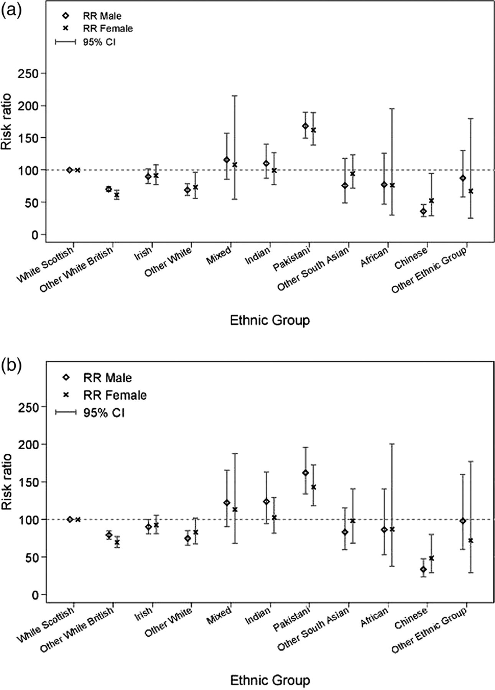

First myocardial infarction age adjusted risk ratios with 95% CI 1 May 2001 to 30 April 2008 in people 30–74 years, by ethnic group and sex.
(a) Age adjusted only
(b) Age and education adjusted
Bansal N et al. BMJ Open 2013; http://bmjopen.bmj.com/content/3/9/e003415.full.pdf+html
Notes:
First myocardial infarction age adjusted risk ratios with 95% CI 1 May 2001 to 30 April 2008 in people 30–74 years, by ethnic group and sex.
(B) First myocardial infarction age and education adjusted risk ratios with 95% CI 1 May 2001 to 30 April 2008 in people 30–74 years, by ethnic group and sex.
Adjustment for education (as a proxy for SEP) had some effects.
[From the paper: “Figure 1A,B shows that adjustment for education did
not remove these differences (figures restricted to cohort of individuals who have education data, 30– 74 years of age). This adjustment attenuated some, but
not all, of the lower risk in the other white British (from 70.6 to 79.4 in men and from 61.2 to 69.8 in women) and other white (from 69.2 to 75.0 in men, and from
73.6 to 83.1 in women) group. In the Chinese group, adjustment for education resulted in lower RRs (from 36.1 to 33.9 in men, and from 52.6 to 48.5 in women)
increasing the difference relative to the white Scottish. For Pakistani men, there was a slight attenuation of risk on education adjustment (from 168.2 to 162.2), whereas
in Pakistani women, 20%”]
Note – calculated from the paper: Risk ratio % change is defined as (adjusted/crude estimate) -1 where the risk is higher than the reference group and (crude/adjusted estimate)-1 where the risk is lower (same way as for Fischbacher’s paper following in this talk)

Slide 27
Percentage change in age-adjusted risk ratio for CVD following further adjustment for census derived socio-economic variables
 | Change after adjustment for :
Ethnic group | Individual NS-SeC* | Economic activity**
Male
Other White British | −1% | −2%
Indian | 2% | 2%
Pakistani | −2% | −2%
Black | 1% | 3%
Female
Other White British | −27% | −1%
Indian | −14% | −5%
Pakistani | −2% | −16%
Black | 13% | −2%
*Four categories from 1 Managerial and Professional to 2 Intermediate to 3 Routine and manual to 4 Never worked and long term unemployed.
** Any compared to no economic activity in last week
Percentage changes are changes in relative risks after adjustment for each factor separately, calculated in relation to the risk for White Scottish which provides a baseline value of 1.
Adapted from table 2 in Fischbacher C,M., Cezard G, Bhopal RS, Pearce J, Bansal N. Measures of socioeconomic position are not consistently associated with ethnic differences in cardiovascular disease in Scotland: methods from the Scottish Health and Ethnicity Linkage Study (SHELS). Int J Epidemiol 2013 12/19;43(1):129-139 http://ije.oxfordjournals.org/content/43/1/129.
Notes:
SHELS has examined, for CVD, the effects of area deprivation and other potential confounders and mediators of the relationship between ethnicity and age-adjusted risk of CVD. The full table shows the percentage change in the age adjusted risk ratio in relation to White Scottish as a result of additional adjustment for area deprivation, individual and household highest educational level, individual and household occupational social class, car ownership, household tenure and economic activity in the past week. I’ve selected individual social class and economic activity as interesting examples for the slide.
There was a negligible percentage reduction in relative risk of CVD from adjustment for social class for Other White British men. For Pakistani men (in contrast with Pakistani women) there was actually a small percentage increase in CVD relative risk (2%) after adjustment for individual social class.
For Other White British and Indian women the risk relative to White Scottish women (adjusted for age) reduced by 27% and 14% respectively after further adjustment for individual social class across four categories from unemployed/never worked to Managerial/professional.
For Pakistani women, the risk relative to White Scottish women (adjusted for age) reduced by 16% after further adjustment for economic activity – one of the largest percentage reductions in relative risk for economic activity for any ethnic group of either sex.
The change was in fact a reduction in risk ratio, as we can see from further multivariate models adjusting for combinations of these variables, and these clearly show part of their increased risk is accounted for by low level of economic activity; if they were compared with a population of similar low levels of economic activity they would not look so bad.
Scottish data are now being used to do more than just describe the variations in health between ethnic groups, but to begin to develop explanatory hypotheses that are grounded in robust evidence. These data suggest that, in comparison to other ethnic groups, low occupational status/unemployment have particular influence on CVD risk for other White and Indian women, and low economic activity levels have a particular influence on CVD risk for Pakistani women
Table Note: Percentage defined as (adjusted/crude estimate)-1 where the risk is higher than the reference (White Scottish) group and (crude/adjusted)-1 where the risk is lower. A positive figure indicates that the association increased in absolute magnitude after adjustment (both increased and decreased risks became more extreme) A negative figure indicates an attenuation of the association so that both increased and decreased risks approached the null value. Data are for age 30-74 years only.
[If the mechanisms in society which produce and then sustain poverty are at root all forms of discrimination, then do we not need to examine how this web of discrimination operates along both socio-economic and particular population group dimensions, to find out both how people are pushed down the slippery slope of disadvantage and ill-health and also how they become trapped at the bottom of it?]

Slide 28
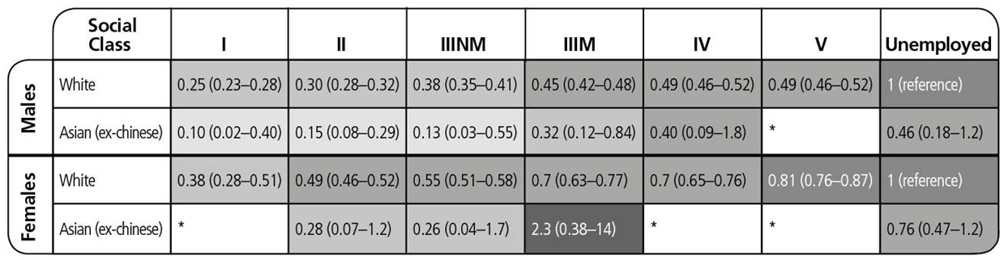
Heat map showing the hazard ratios for all-cause mortality (95% CI) by social class, unemployment and ethnicity for those aged 16-64 years in April 1991 (1991-2009)
2.3 (0.38-14)
*It was not possible to calculate a hazard ratio for these groups because of the small number of deaths
Millard A.D., Raab G., Lewsey J., Eaglesham P., Craig P., Ralston, K., McCartney G., Equality, inequality and mortality in Scotland (unpublished draft report)
Notes:
The Scottish Longitudinal Study links census data for a 4% sample of the Scottish population to a variety of other records. One project linked all-cause mortality data with 1991 census data to create a survival analysis using Cox’s proportional hazards regression. Relative indices of inequality by social class and by area deprivation were calculated using the hazards produced from the Cox regression. There were increased hazards with increasing area deprivation for white people, but the pattern was less clear for Asian people.
It seems Asian women in manual work have a particularly high mortality hazard even in comparison to unemployed white women. So these data are starting to tell us a story, but we do not yet know where it will end.

Slide 29
Final key summary points
A lot of quantitative demographic data available
Less immediately available are data on health by ethnicity and migration over time and within local Scottish geographies
Linkage possibilities are now very promising to fill these gaps as required
Confidentiality needs may limit the scope for fine-tuning quantitative analyses to particular groups, times and places
Qualitative analyses could help there.
Notes:
Maybe it would be useful if our planners had access to information that could combine ethnicity and migration to better predict the likely size of each ethnic group 20 or 50 years in the future. Although attempts have been made to predict the growth of current ethnic minorities for the UK using fertility statistics and future migration,(Rees,P. 2012) the use of migration is problematic as it is sensitive to unpredictable global trends and events. A similar (unpublished) attempt has been made to predict Ethnic Population Projections for Scotland, 2001 to 2051 http://www.gro-scotland.gov.uk/files2/stats/seminars/10-pams-seminar-oct2011-phil-rees.pdf
Rees P, Wohland P, Norman P, Boden P. Ethnic population projections for the UK, 2001-2051. Journal of Population Research 2012 04.01.2012 http://link.springer.com/article/10.1007/s12546-011-9076-z/fulltext.html.

Slide 30
Useful Links
National Records Scotland (NRS) migration pages http://www.nrscotland.gov.uk/statistics-and-data/statistics/statistics-by-theme/migration
International passenger survey (IPS) http://www.ons.gov.uk/ons/about-ons/get-involved/taking-part-in-a-survey/information-for-households/a-to-z-of-household-and-individual-surveys/international-passenger-survey/index.html
National Health Service Central Register (NHSCR) http://www.nrscotland.gov.uk/statistics-and-data/nhs-central-register
Community Health Index (CHI) http://www.ndc.scot.nhs.uk/Dictionary-A-Z/Definitions/index.asp?Search=C&ID=128&Title=CHI%20Number
Labour Force Survey (LFS) http://www.ons.gov.uk/ons/about-ons/get-involved/taking-part-in-a-survey/information-for-households/a-to-z-of-household-and-individual-surveys/labour-force-survey/index.html
National Insurance Recording and Pay as you Earn System (NPS). https://www.gov.uk/national-insurance/overview
Scottish Ethnic and Migrant Health Research Strategy and Steering Group
http://www.healthscotland.com/resources/networks/SHERRS.aspx
ScotPHO Migration pages http://www.scotpho.org.uk/population-dynamics/migration/introduction
Scottish Government population and migration pages http://www.scotland.gov.uk/Topics/Statistics/Browse/Population-Migration

Slide 31
Thank you
Andrewmillard@nhs.net
Notes:
Thank you for listening.

